Slide 1

Diabetes Readmission Risk AI Dashboard: Predictive Modeling + GenAI Assistant
Presented by: Gobinath Subramani
Date: 10th July 2029
Context: DHL Data Science Assignment – Executive Insights Presentation
Notes:
Good afternoon, my name is Gobinath Subramani, and today I’m excited to present my project titled:
‘Diabetes Readmission Risk AI Dashboard: Predictive Modeling + GenAI Assistant.’
This end-to-end solution combines traditional machine learning with generative AI to provide actionable insights for healthcare teams, enabling early risk detection, explainability, and smart assistant features tailored for decision-makers.

Slide 2

BUSINESS OBJECTIVE
🎯 Why This Matters for DHL
DHL is exploring the healthcare sector to enhance service offerings for chronic conditions like diabetes.
Diabetes affects millions globally, with growing cost and complexity.
Readmission risk insights can drive:
Better patient engagement
Optimized health partnerships
Improved long-term health outcomes
Notes:
To begin with, let’s understand why this project matters for DHL.
DHL is actively exploring how it can expand its services in the healthcare sector, especially around chronic conditions like diabetes, which are rising in both prevalence and cost globally.
Hospital readmissions are a key issue here, they’re expensive, often preventable, and negatively impact patient well-being.
So the goal is to leverage AI to generate insights on readmission risk, which in turn enables better patient engagement, strengthens DHL’s partnerships with healthcare providers, and supports improved long-term health outcomes.
In short, this isn’t just about predicting numbers, it’s about unlocking new value through personalised, data-driven care capabilities.

Slide 3

CHALLENGES
⚠️ Current Gaps in Diabetic Care
Hospital readmissions within 30 days are:
Costly for providers and insurers
Often a sign of inadequate discharge planning or follow-up care
Traditional methods struggle to:
Identify at-risk patients early
Offer personalized support
Scale across thousands of patient records
Notes:
Let’s now look at why this problem matters.
Hospital readmissions within 30 days are a major cost driver for both healthcare providers and insurers. But more importantly, they’re often a signal that something went wrong, either the patient was discharged too early or didn’t receive adequate follow-up care.
Traditional methods struggle to proactively identify high-risk patients. They’re not built to handle large-scale data or offer personalized insights.
And that’s where AI and data science can bring real value, by enabling early detection and tailored interventions at scale

Slide 4

SOLUTION APPROACH
PHASE 1: Data Ingestion & Profiling
Started from CSV files provided in the assignment.
Ingested cleaned data into AWS RDS (MySQL) for scalable querying and multi-phase processing.
Standardized missing values, removed duplicates, and dropped constant columns.
Notes:
I started with the raw CSV files provided in the assignment.
To ensure scalability and modular development, I ingested and managed the cleaned data inside an AWS RDS MySQL database. This gave me flexible access across all phases, from profiling to model training.
In this step, I also handled missing values, removed duplicates, and eliminated constant or low-variance columns to reduce noise.
This foundational cleanup was crucial to ensure quality data fed into downstream analytics and modeling.

Slide 5
SOLUTION APPROACH
PHASE 2: Feature Engineering
Created advanced features capturing:
Medication complexity
Visit behaviour (frequent inpatient, long stay)
Comorbidity flags (e.g., hypertension, infection)
Binned lab results, encoded age groups, interaction term
Notes:
After ingestion, I moved to crafting meaningful features from raw data to better capture patient risk signals.
I engineered new variables such as medication complexity, patterns of visit behavior like long stays or frequent readmissions, and comorbidity flags such as hypertension or infections.
I also binned lab results, encoded age groups into ranges, and added interaction terms to enrich the model’s understanding.
This phase helped translate clinical data into predictive intelligence that a model could truly learn from.”

Slide 6
SOLUTION APPROACH
PHASE 3: Feature Selection
Applied filters (low variance, high correlation) to reduce dimensionality.
Ranked and retained the top 100 predictive features using RandomForest.
Saved refined feature set to RDS for reproducibility.
Notes:
Once features were engineered, I needed to reduce dimensionality and remove noise to ensure model performance and interpretability.
I applied basic filters to drop features with low variance or high correlation and then ranked the remaining ones using a RandomForest model based on importance scores.
The top 100 most predictive features were selected, and I stored this refined dataset back into AWS RDS to ensure reproducibility across later phases.”

Slide 7
SOLUTION APPROACH
PHASE 4: Model Training & Evaluation
Handled class imbalance via SMOTE oversampling.
Trained & tuned multiple models: RandomForest, Gradient Boosting, HistGradientBoosting.
Best model selected by ROC AUC, saved as best_model_top100.pkl.
Notes:
At this stage, I addressed class imbalance using SMOTE, which is crucial since readmission events are relatively rare.
I trained and tuned multiple models — RandomForest, Gradient Boosting, and HistGradientBoosting, using a consistent pipeline and tracked performance using ROC AUC as the key metric.
Among the models, HistGradientBoosting performed the best with an AUC of 0.6814, and I saved it as best_model_top100.pkl.
I also used MLflow to log all experiments, metrics, and parameters, ensuring transparency and reproducibility for future tuning or productionization.

Slide 8
SOLUTION APPROACH
PHASE 5: Explainability
Applied SHAP for interpretability:
Summary plot: global drivers
Waterfall plot: individual patient insights
Notes:
To make the predictions understandable and actionable, I used SHAP, a powerful interpretability technique.
At a global level, I generated a summary plot to show the top drivers influencing readmission across all patients. For example, insulin status, medication changes, and discharge disposition were key contributors.
More importantly, at a patient level, I used SHAP waterfall plots. These provide a transparent breakdown of what features increased or decreased the risk score for a specific individual.
This helps build trust and explainability for clinicians and enables better decisions based on ‘why’ a patient is considered high-risk.

Slide 9
SOLUTION APPROACH
PHASE 6: GenAI Integration (Amazon Bedrock)
Connected to Mistral via AWS Bedrock to:
Generate personalized patient summaries
Enable natural language Q&A
Translate ICD-9 codes into plain English
Notes:
To enhance the value beyond prediction, I integrated Mistral-7B using AWS Bedrock.
This allowed me to generate human-readable summaries of a patient’s risk profile, including gender, inpatient history, medication use, and hypertension status — all personalized per patient.
I also enabled a natural language Q&A assistant where stakeholders can ask contextual questions like ‘What are top causes of readmission for patients over 60?’ and receive LLM-powered insights instantly.
Finally, I added a feature to translate complex ICD-9 codes into plain English for medical or non-technical staff, improving collaboration across teams.

Slide 10
SOLUTION APPROACH
PHASE 7: Interactive Dashboard Deployment
Built a professional Streamlit dashboard hosted on EC2:
Predicts risk scores
Visualizes top risk factors (SHAP)
Allows GenAI-based Q&A
Generates PDF clinical summaries for stakeholders
Notes:
To make this AI capability accessible, I developed a fully interactive Streamlit dashboard and deployed it on an AWS EC2 instance.
The dashboard: Predicts readmission risk scores for any selected patient.
Visualizes the SHAP-based top contributing features to help understand model decisions.
Integrates GenAI via AWS Bedrock to power real-time patient summaries and natural language Q&A.
Allows clinical summaries to be exported as PDF for reporting or coordination.
This ensures the AI solution is not only accurate, but also actionable and user-friendly for healthcare stakeholders.

Slide 11
DATA INGESTION & EXPLORATION
Overview:
I ingested over 100,000 patient records from the publicly available UCI Diabetes dataset.
The raw CSV files were loaded into AWS RDS (MySQL) for scalable querying and downstream integration with ML pipelines.
Key Highlights:
✅ Structured data spanning hospital admissions from 1999 to 2008
✅ Included demographics, diagnoses, lab tests, medications, and discharge outcomes
✅ Initial profiling showed:
50+ categorical variables
Multiple missing values & data inconsistencies
Several redundant or constant columns
Notes:
I started by ingesting over 100,000 structured patient records from the UCI Diabetes dataset.
Instead of working with raw CSV files locally, I chose to load the cleaned dataset into AWS RDS (MySQL) — enabling scalable querying and future integration with ML pipelines or dashboards.
The dataset spanned hospital admissions from 1999 to 2008, including key clinical variables like demographics, diagnoses, lab tests, medications, and discharge details.
From my initial profiling, I discovered:
Over 50 categorical variables, many with high cardinality.
Several missing values and inconsistent formats.
And a number of redundant or constant columns, which I flagged early for removal.
This step helped lay a solid foundation for reliable and interpretable model development.

Slide 12
DATA INGESTION & EXPLORATION
Tools Used:
Pandas & SQLAlchemy for ingestion and cleanup
AWS RDS (MySQL) for centralized data storage
Early EDA using pandas-profiling and visualization tools to spot outliers and imbalances
Notes:
For ingestion and cleanup, I used Pandas and SQLAlchemy.
The data was stored in AWS RDS (MySQL) to allow scalable access and downstream integration.
For early data exploration, I leveraged tools like pandas-profiling and basic visualizations to uncover outliers and imbalances quickly.

Slide 13
KEY INSIGHTS – EDA & FEATURE ENGINEERING

Slide 14
DATA CLEANING & PROFILING
Standardized missing values (e.g., '?', 'Not Mapped', 'Unknown/Invalid')
Dropped constant and duplicate columns (e.g., weight, payer_code)
Converted age ranges into numeric midpoints
Mapped coded columns to descriptions for readability (e.g., admission_type, discharge_disposition)
Created new binary flags:
is_male, readmitted_flag, A1C_flag, med_change
Notes:
Once the data was ingested into AWS RDS, I moved into cleaning and profiling to prepare it for modeling.
First, I addressed missing values and inconsistencies. Several columns had non-standard entries like '?', 'Not Mapped', or 'Unknown/Invalid', which I standardized across the dataset to avoid downstream bias.
Then I dropped constant and duplicate columns, like weight and payer_code, which added no predictive value. This helped reduce dimensionality.
I converted age ranges into numerical midpoints, for instance, the category [70–80) was mapped to 75, to support algorithms that expect numeric input.
To make the dataset more human-readable, I mapped coded fields like admission_type and discharge_disposition to their actual medical meanings using the data dictionary.
Finally, I created new binary flags that I knew could be strong predictors, such as whether a patient was male (is_male), had a recent A1C test (A1C_flag), or was readmitted (readmitted_flag).
These steps ensured the data was clean, interpretable, and feature-rich before advancing to feature engineering and modeling

Slide 15
DOMAIN FEATURE ENGINEERING
Created medication complexity score based on 21 drug features
Added risk behaviour flags:
frequent_inpatient, long_stay, complex_treatment
Engineered comorbidity indicators using ICD-9 codes:
has_ketoacidosis, has_hypertension, has_infection
Built interaction terms:
diabetesMed × insulin, num_medications × time_in_hospital
Added ordinal binning (e.g., age, num_lab_procedures)
Applied frequency encoding to high-cardinality categorical features
Notes:
After profiling and cleaning the data, I focused on extracting meaningful features using healthcare-specific logic.
I created a medication complexity score derived from 21 different drug-related features. This helps quantify how difficult a patient’s treatment plan might be.
I also built risk behaviour flags to capture patients with patterns like frequent hospitalizations or long stays, these are early signals of instability in care.
Using ICD-9 codes, I engineered comorbidity indicators such as whether the patient had ketoacidosis, hypertension, or infections — conditions known to increase readmission risk.
To capture nonlinear relationships, I created interaction terms like medication count multiplied by hospital stay duration.
Then, I applied ordinal binning on continuous variables like age and number of lab tests to help tree-based models generalize better.
Finally, for high-cardinality columns like diagnostic codes, I applied frequency encoding to keep the model interpretable without losing granularity.
These domain-informed features significantly enriched the dataset and helped the model better distinguish high-risk profiles from low-risk ones.

Slide 16
HANDLING IMBALANCE & FEATURE SELECTION

Slide 17
CLASS IMBALANCE HANDLING
📉 Class Imbalance Handling
The dataset had imbalanced target labels: only ~11% were readmitted within 30 days.
Applied SMOTE (Synthetic Minority Oversampling Technique) to balance the training set:
Increased minority class representation without information loss
Improved model generalization and fairness
Notes:
One key challenge I identified during modeling was class imbalance; only about 11% of patients were readmitted within 30 days.
If not addressed, this could lead the model to be biased toward predicting ‘No Readmission’ for everyone just to achieve high accuracy.
To fix this, I applied SMOTE, a proven technique that synthetically generates new samples for the underrepresented class.
This helped in two ways:
First, it improved the model’s sensitivity to truly detect high-risk cases.
Second, it enabled fairer learning, reducing bias in predictions.
This step was critical to make the AI not just accurate, but also clinically useful.

Slide 18
FEATURE SELECTION
⭐ Feature Selection
Trained Random Forest on SMOTE-balanced data to compute feature importances
Selected the Top 100 most important features
Based on impact on AUC performance
Saved to selected_100_features.csv for consistent reuse
📊 Benefits
Reduced overfitting risk
Improved training efficiency
Retained clinical interpretability of top drivers (e.g., number_inpatient, insulin, A1C_flag)
Notes:
To make the model faster, cleaner, and more interpretable, I ran a feature selection process.
I trained a Random Forest model on the SMOTE-balanced dataset to compute importance scores.
Then I retained the Top 100 features that had the strongest impact on model performance, specifically on AUC score.
This step had 3 major benefits:
It reduced overfitting, keeping the model generalizable.
It boosted training speed significantly.
Most importantly, it preserved clinical interpretability, with key features like number of inpatient visits, insulin use, and A1C levels remaining in the final set.

Slide 19



MODEL EVALUATION & FINAL SELECTION

Slide 20
MODEL EVALUATION
🧪 Models Evaluated
Random Forest
Gradient Boosting
✅ HistGradient Boosting Classifier
🎯 Evaluation Metric
ROC AUC Score – Ideal for imbalanced datasets where accuracy alone is misleading.
Notes:
After preparing the feature set, I evaluated several machine learning models:
Random Forest
Gradient Boosting
✅ And the best-performing: Histogram-based Gradient Boosting Classifier (HistGradientBoosting)
Given that the data is imbalanced, only about 11% of patients were readmitted. I chose ROC AUC as the primary evaluation metric, which is more reliable than simple accuracy in these cases.
The winning model offered the best trade-off between true positives and false positives, and was selected for downstream explainability and deployment.

Slide 21
PERFORMANCE SUMMARY
📊 Performance Summary
Model | ROC AUC Score
Random Forest | 0.6776
Gradient Boosting | 0.6806
✅ HistGradient Boosting | 0.6814
Notes:
Here’s a quick comparison of the models I trained, evaluated using the ROC AUC score, which is well-suited for imbalanced datasets like ours.
While all three models performed similarly, Histogram-based Gradient Boosting achieved the highest AUC of 0.6814, making it the most effective at separating high-risk patients from low-risk ones.
Even though the score may not seem very high, it’s a solid baseline considering the limited timeframe, and it gives us a strong foundation for further enhancement through clinical feature tuning or deep learning in future phases.

Slide 22
FINAL SELECTION: HISTGRADIENT BOOSTING
✅ Reasons for Selection:
Outperformed others in AUC score
Handles missing values natively — no need for prior imputation
Fast and scalable with categorical encoding + histogram optimization
Robust for structured tabular data like EHRs (Electronic Health Records)
Notes:
After evaluating several models, I selected Histogram-based Gradient Boosting as the final model for deployment, and here’s why:
It delivered the highest AUC score, outperforming the other contenders.
It natively handles missing values, which reduces preprocessing overhead.
It’s fast and scalable, thanks to its built-in categorical encoding and histogram optimization.
Most importantly, it’s well-suited for structured EHR data, making it a reliable choice for real-world hospital environments.
This model gives me the best balance of accuracy, explainability, and production readiness within the time constraints.

Slide 23
FINAL SELECTION: HISTGRADIENT BOOSTING
🔁 MLflow Integration
Used for tracking experiments and versioning:
Logged hyperparameters and metrics
Saved top 100 selected features and final model
Enabled seamless comparison and reproducibility
Notes:
To ensure reproducibility and experiment tracking, I integrated MLflow into my workflow.
It allowed me to track all experiments, including hyperparameters, AUC scores, and model artifacts.
I logged the top 100 selected features, along with the final HistGradient Boosting model.
This gave me the ability to version models, easily compare experiments, and rerun configurations reliably — a crucial practice in any scalable Data Science workflow
Overall, MLflow made the entire modeling process transparent, organized, and production-ready.

Slide 24
MODEL PERFORMANCE – INTERPRETING THE RESULTS

Slide 25
OBSERVED OUTCOME
📈 Observed Outcome
Best model ROC AUC: 0.6814
Indicates moderate predictive power on unseen data
✅ Justification
This assignment was completed within a 24-hour time-boxed window
The dataset presents significant real-world challenges:
Highly imbalanced classes (readmitted vs. not)
Sparse or missing values in clinical codes
Complex patient heterogeneity (medications, comorbidities, visits)
Notes:
Here’s the outcome of my model:
The best model achieved a ROC AUC of 0.6814, which indicates moderate predictive power on unseen hospital data.
It’s important to highlight that this solution was developed in a 24-hour time-boxed window, from data ingestion to full dashboard deployment.
Despite the tight timeline, the dataset itself posed real-world challenges:
It had high class imbalance – only ~11% of patients were readmitted.
There were many missing or inconsistent values in clinical features.
And patients had complex medical profiles, with varying medications, comorbidities, and visit behaviors.
So even with these constraints, the model offers a solid starting point and lays the foundation for further improvements in predictive diabetic care.

Slide 26
OBSERVED OUTCOME
🚀 Future Opportunity for Improvement
If extended further, performance can be improved by:
Fine-tuning model hyperparameters using Bayesian optimization
Incorporating temporal visit patterns and ICD-9 code embeddings
Using ensemble stacking or deep learning models
Collecting more domain-specific patient cohorts (e.g., age + care type)
Clinician-in-the-loop feedback for explainability and trust
💡 Bottom Line
While the model is production-ready, it validates the feasibility of building a GenAI-powered predictive solution using real patient data and forms a strong technical foundation for DHL’s health analytics capability.
Notes:
“While the current model demonstrates good feasibility, there are clear opportunities to push performance further if given more time or in a production setting.
🔧 Some potential next steps include:
Fine-tuning hyperparameters using more advanced techniques like Bayesian optimisation.
Incorporating temporal visit patterns and even ICD-9 code embeddings, to better represent how a patient’s condition evolves over time.
Exploring deep learning or ensemble stacking techniques for stronger predictive performance.
Collecting more targeted patient cohorts, such as elderly diabetic patients or ICU stays, can refine model accuracy for specific use cases.
And importantly, embedding clinician-in-the-loop feedback would help refine features and improve trust in the model’s predictions.

Slide 27
MODEL EXPLAINABILITY WITH SHAP

Slide 28
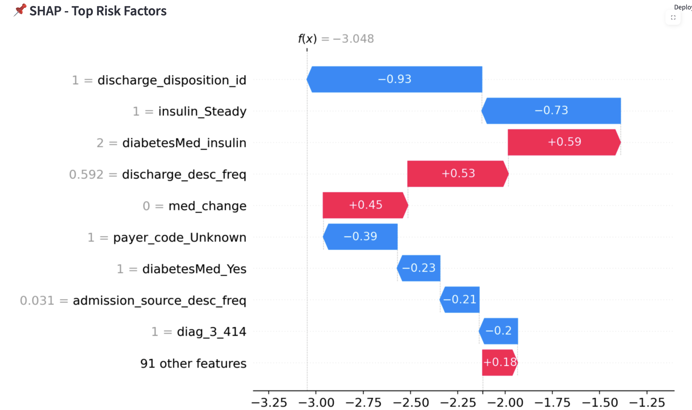
MODEL EXPLAINABILITY
🧠 Explainability Techniques
SHAP Summary Plot: Identifies the top global features influencing readmission risk
SHAP Waterfall Plot: Breaks down individual patient predictions in a transparent, visual way
💼 Value to Managers & Clinicians (Business Value)
Improves trust in AI decisions by explaining why a patient is high-risk
Enables clinically actionable insights to support personalized care
Bridges the gap between black-box models and real-world decision-making
Notes:
To ensure transparency and build trust with clinicians and business leaders, I integrated SHAP explainability into the pipeline.
I used two SHAP-based visualizations:
• SHAP Summary Plot – This shows the top global drivers influencing readmission risk across the entire dataset. For example, factors like discharge disposition, insulin usage, and medication changes emerged as strong indicators. • SHAP Waterfall Plot – This breaks down individual patient predictions in a visual and interpretable way. Each factor is shown with its positive or negative contribution to the final score.
From a business and clinical perspective, this interpretability:
• Builds trust by explaining why a prediction was made.
• Supports clinically actionable decisions, like prioritizing patient follow-up.
• And helps bridge the gap between black-box ML models and real-world adoption in healthcare settings.

Slide 29
GENAI INTEGRATION – BUSINESS ENHANCEMENT

Slide 30
GenAI Integration
🤖 Why GenAI?
To enhance explainability, accessibility, and decision support across clinical, analytical, and operational users.
🔌 What I Integrated
Leveraged Mistral-7B via Amazon Bedrock to provide:
🧬 Patient Summary Generator
Generates plain-language summaries for clinicians and case managers
📊 Data Assistant Q&A
Natural language Q&A interface for exploring patterns and KPIs
🩺 ICD-9 Medical Code Explainer
Explains diagnosis codes in simple terms for broader understanding
Notes:
To make the AI outputs more accessible and useful for clinicians, analysts, and business users, I integrated Generative AI using Mistral-7B via Amazon Bedrock
Traditional ML models give us predictions, but they don’t communicate why in natural, human-friendly language. GenAI bridges that gap, enhancing explainability, accessibility, and decision support.
I designed three GenAI-powered modules using Mistral-7B to add business value and operational ease:
🧬 Patient Summary Generator
➤ Transforms raw model outputs into plain-English summaries, useful for clinicians and discharge planners.
📊 Data Assistant Q&A
➤ Enables users to ask questions like ‘What are top factors for this patient group?’ and receive natural language insights, empowering non-technical users.
🩺 ICD-9 Medical Code Explainer
➤ Converts complex diagnosis codes into simple explanations to aid both clinical and administrative understanding.

Slide 31
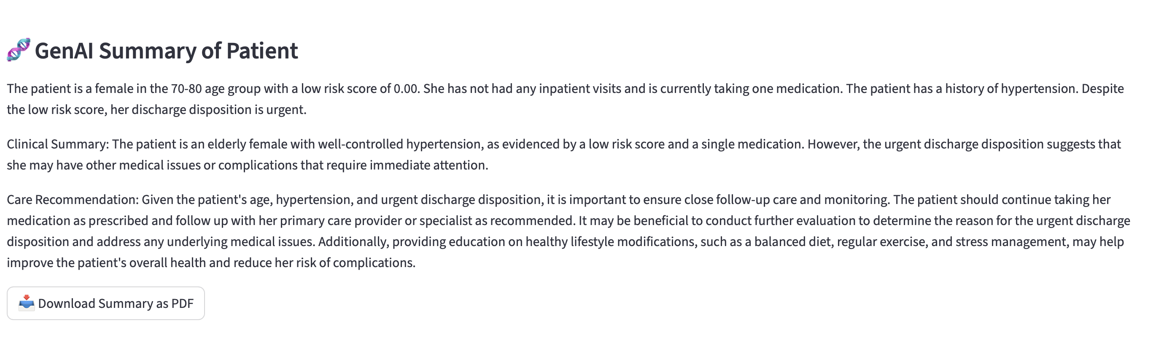
PATIENT SUMMARY GENERATOR
Generates a clinically meaningful summary for each patient based on their risk score and key features.
Uses the predicted readmission risk score (from the ML model)
Translates complex data (e.g., lab visits, medications, comorbidities) into natural language
Supports clinicians and care managers to quickly understand patient profiles and take action
Notes:
One of the most powerful GenAI features I built was a Patient Summary Generator, which automatically produces a clinically meaningful narrative based on each patient’s predicted risk and key medical indicators.
✅ It uses the ML-predicted readmission score along with key features like visit history, medications, and comorbidities.
✅ The system translates structured medical data into plain, actionable language using Mistral-7B via Bedrock.
✅ This helps clinicians quickly understand a patient’s status and decide next steps.
This is an actual example of a generated summary. It provides:
A concise patient description (e.g., age, risk level, medical history),
A clinical explanation of their status,
And a clear recommendation, all written in natural language.”
🧾 This can also be downloaded as a PDF for record-keeping or handover documentation.

Slide 32
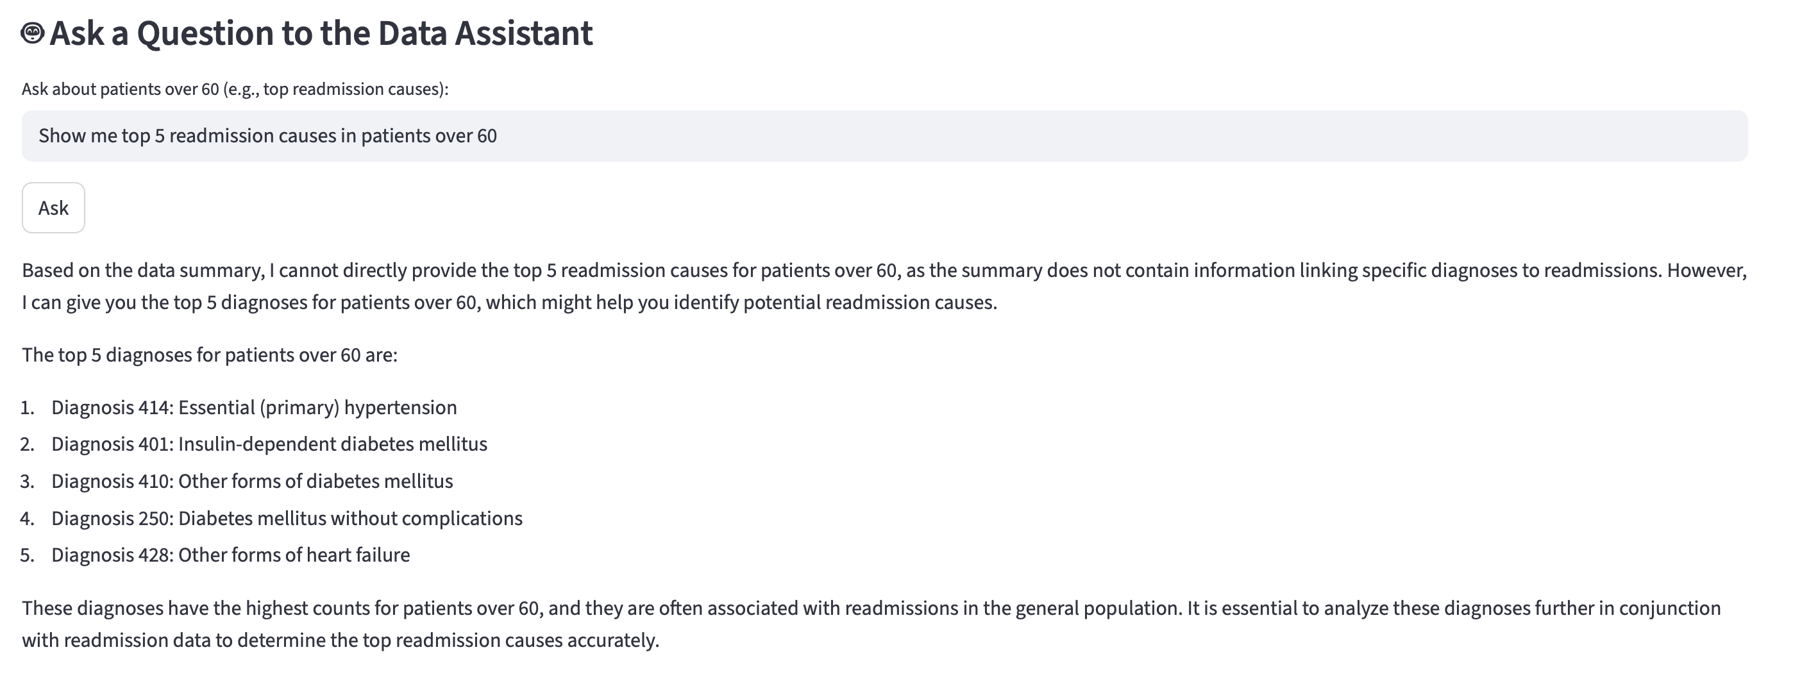
DATA ASSISTANT Q&A
Enables natural language querying over patient data summaries.
Analysts can ask questions like:
“What are the top readmission factors for seniors?”
“Show readmission rate by medication complexity.”
Empowers non-technical teams to extract insights without SQL or coding
Notes:
“To make the system accessible beyond data scientists, I integrated a GenAI-powered assistant that allows natural language questions over patient data.”
🔍 Analysts can ask things like:
‘What are the top readmission causes for seniors?’
‘Show trends by medication complexity’
✅ No SQL or coding needed, it empowers non-technical teams to get insights instantly.
“This makes data exploration frictionless across roles, from clinicians to business analysts.

Slide 33
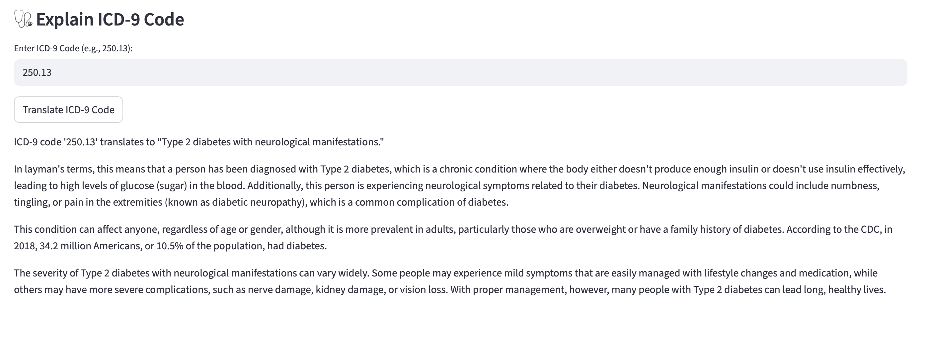
ICD-9 Code Explainer for Medical Staff
Decodes medical ICD-9 diagnosis codes in plain English.
Enhances understanding of diagnosis codes for nurses, case workers, or non-specialists
Promotes clarity in care coordination and discharge planning
Notes:
To support non-clinical staff and care coordinators, I integrated an ICD-9 explainer tool using GenAI.
It decodes diagnosis codes like 250.13 into plain English.
Useful for nurses, case workers, and admin teams to understand the condition and its impact.
Promotes better communication during care transitions and discharge planning.
This reduces ambiguity and builds shared understanding across the care team.

Slide 34
FINAL APP DEMO – INTERACTIVE AI DASHBOARD

Slide 35
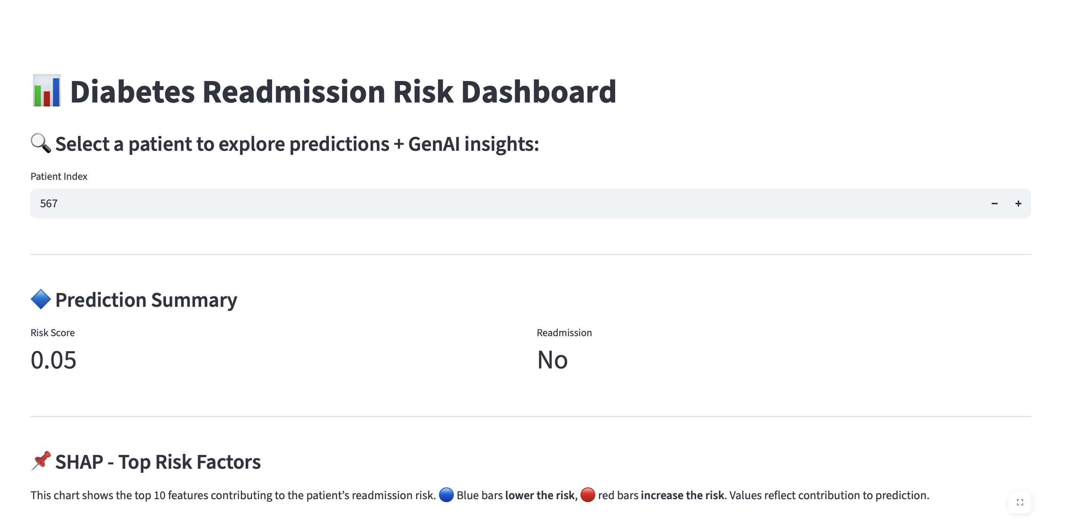
KEY FEATURES DEMONSTRATED
📌 Select a Patient:
View ML-based readmission risk score, SHAP explainability, and a natural language GenAI summary.
🤖 Ask a Question:
Type a query and receive contextual business/clinical insights using the data assistant powered by Mistral-7B.
📥 Export Summary:
Download PDF clinical report for patient handovers or case reviews.
Notes:
This dashboard brings everything together in a user-friendly way. Let me highlight the core features.”
📌 Select a Patient
➤ Shows the ML-predicted readmission risk, SHAP explainability, and a GenAI-generated summary.
🤖 Ask a Question
➤ Analysts can type natural language questions and get contextual clinical/business insights using Mistral-7B.
📤 Export Summary
➤ With one click, generate a PDF clinical report — useful for handover, review, or documentation.
“It’s designed for clinicians, analysts, and coordinators, all in one place.

Slide 36
DEPLOYMENT HIGHLIGHTS
✅ Deployed on AWS EC2 (Streamlit + Docker)
✅ Integrated with AWS Bedrock using Mistral-7B for real-time GenAI reasoning
✅ Data stored in MySQL (RDS)
🌐 Live Demo
Accessible internally at: http://52.65.180.150:8501
Notes:
To demonstrate end-to-end capability, I deployed the full solution in the cloud.
✅ Hosted the app on AWS EC2, using Docker and Streamlit for a smooth frontend.
✅ Integrated Mistral-7B via AWS Bedrock for real-time GenAI responses.
✅ Stored patient data in MySQL (RDS) to support scalable ML queries.
The app is currently accessible at the public demo link shown here.

Slide 37
BUSINESS IMPACT

Slide 38
Strategic Value to DHL
🔍 Early Risk Detection:
Identify high-risk diabetes patients proactively, enabling targeted post-discharge care and reducing avoidable hospital costs.
🤝 Trustworthy AI for Clinical Partners:
Deliver explainable insights that clinicians can act on, building trust and strengthening partnerships with hospitals.
📝 GenAI-Driven Documentation:
Automate patient summaries for insurance, case management, and referrals, improving service turnaround and accuracy.
⚙️ Efficiency at Scale:
Replace manual reviews with an AI assistant, supporting faster insights and better resource use across teams.
Notes:
This solution directly aligns with DHL’s vision to enter the healthcare sector with meaningful AI support.
These combined benefits position DHL to deliver smarter, scalable diabetic care support.

Slide 39

CONCLUSION
✅ Project Highlights
Built a full-stack AI + GenAI solution to predict and explain diabetes readmission risk
Integrated clinical reasoning, SHAP explainability, and AWS Bedrock-powered summaries
Delivered an interactive dashboard with real business utility for DHL’s health initiatives
🚀 Recommended Next Steps
🔄 Integrate with Real-Time EHR Systems for live risk scoring
🧠 Enhance LLM Capabilities to suggest care plans and triage actions
📈 Establish Monitoring Pipelines to detect model drift and ensure clinical relevance
🏥 Pilot Deployment in a selected geography or hospital for field testing
Notes:
To summarize, this project successfully demonstrates how we can combine predictive AI and GenAI to deliver meaningful healthcare insights.
This prototype lays a strong foundation for AI-powered care coordination and expands DHL’s capabilities in digital health services.

Slide 40




THANK YOU!
“Predicting the future isn’t magic, It’s Artiﬁcial Intelligence.”
~Dave Waters
CREDITS: This presentation template was created by Slidesgo, including icons by Flaticon, and infographics & images by Freepik and illustrations by Stories

